Slide 1
Principal Components Analysis (PCA)
Dr. Mrunal Rane

Slide 2
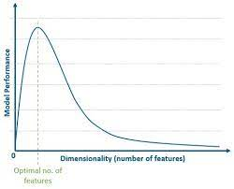
Curse of dimensionality

Slide 3
DR Techniques
Feature Selection
The process of picking a subset of the features
Feature Reduction
Reducing the no. of dimensions in a dataset while retaining as much info as possible
Transforms the data into a lower dimensional space
Keeps a subset of the features

Slide 4
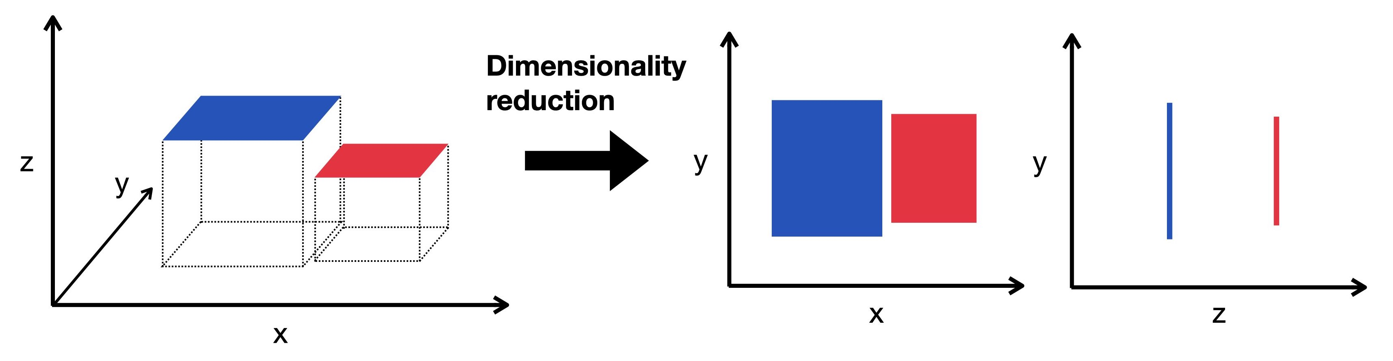
Dimensionality Reduction

Slide 5
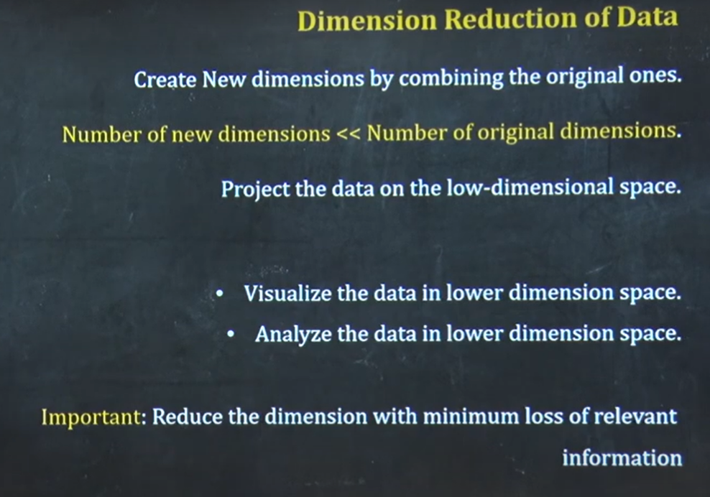

Slide 6
Dimensionality reduction
Transformation of data from a high-dimensional space into a low-dimensional space so that the low-dimensional representation retains some meaningful properties of the original data, ideally close to its intrinsic dimension.

Slide 7
Principle Component Analysis (PCA)
PCA: a statistical procedure
Reduce dimensionality of input vectors
Too many features, some of them are dependent of others
Extract important (new) features of data which are functions of original features
Minimize information loss in the process

Slide 8
This is done by forming new interesting features
As linear combinations of original features (first order of approximation)
New features are required to be linearly independent (to avoid redundancy)
New features are desired to be different from each other as much as possible (maximum variability)

Slide 9
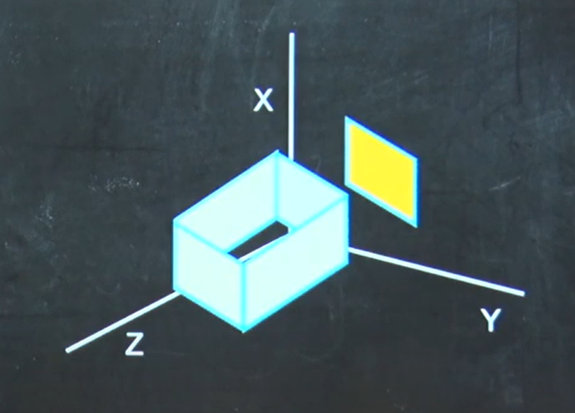
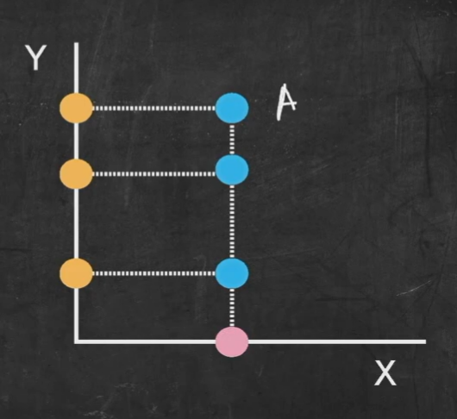
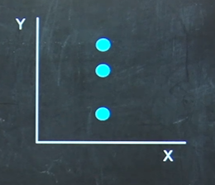

Slide 10
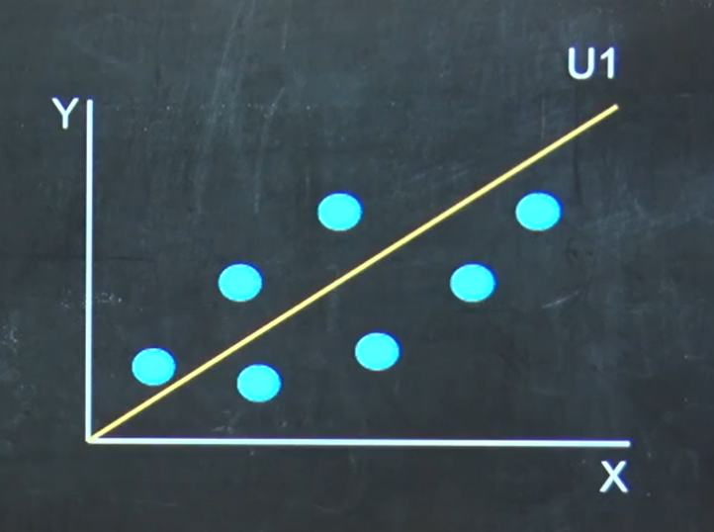
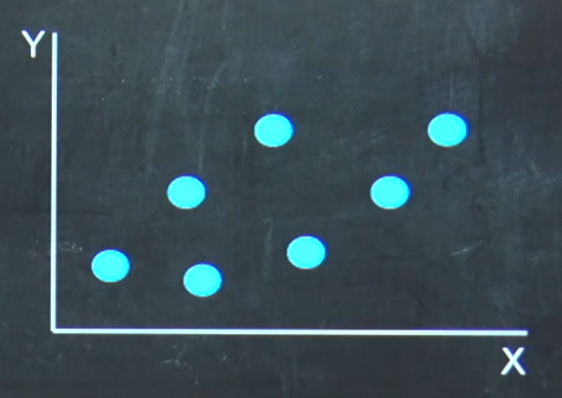

Using new axis

Slide 11
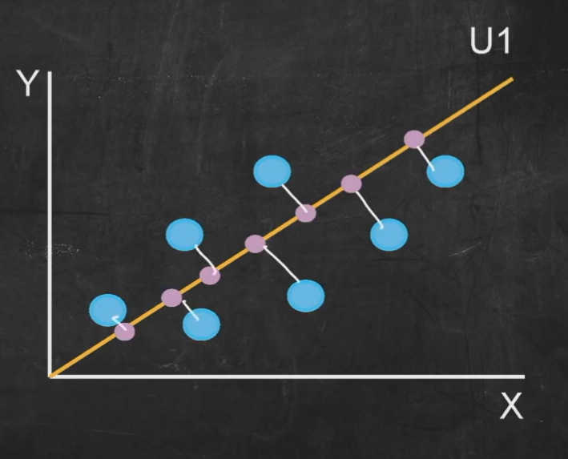

Slide 12
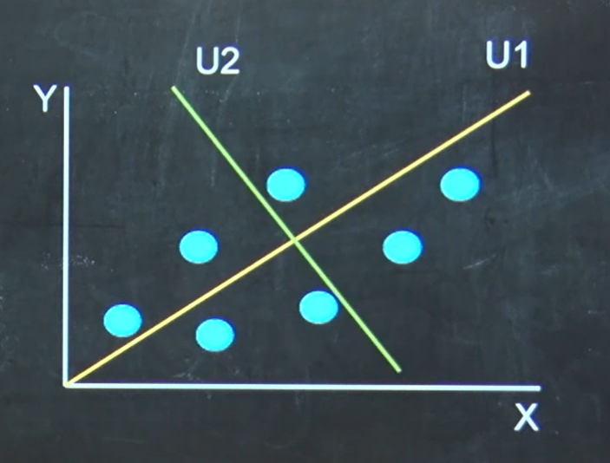

Slide 13
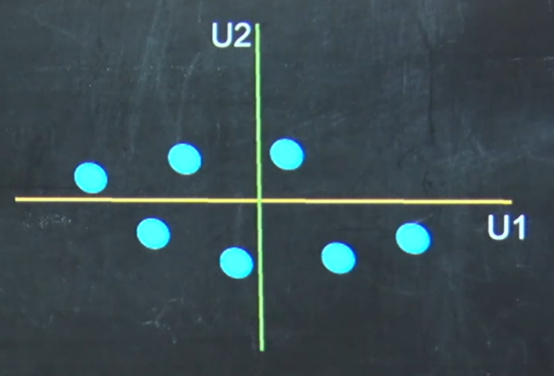

Slide 14
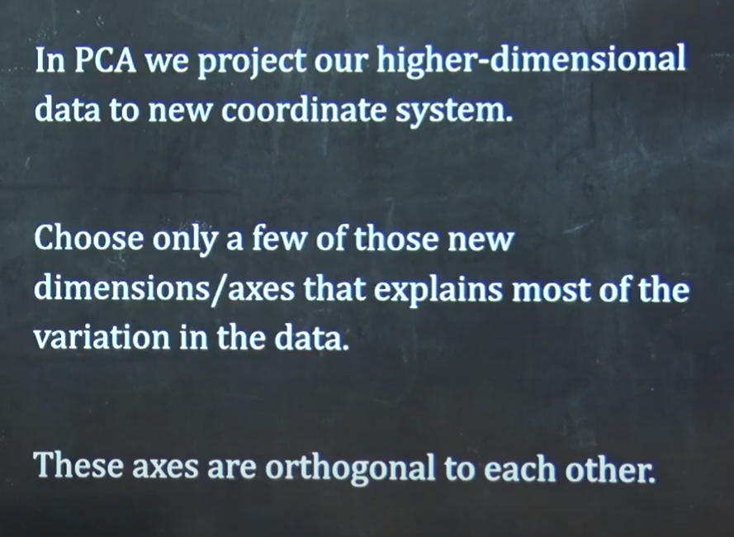
The Essence of PCA

Slide 15
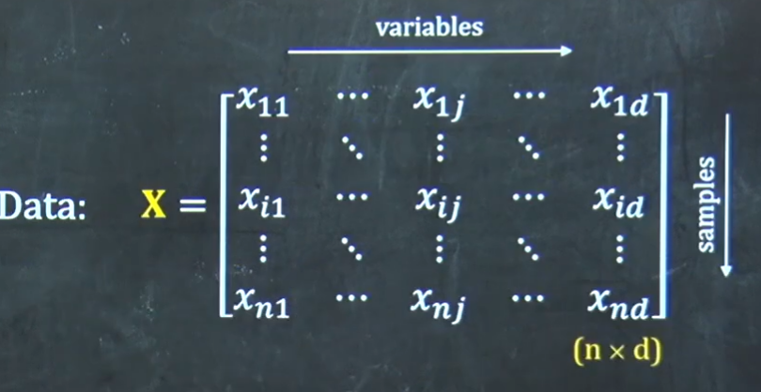

Math behind PCA

Slide 16
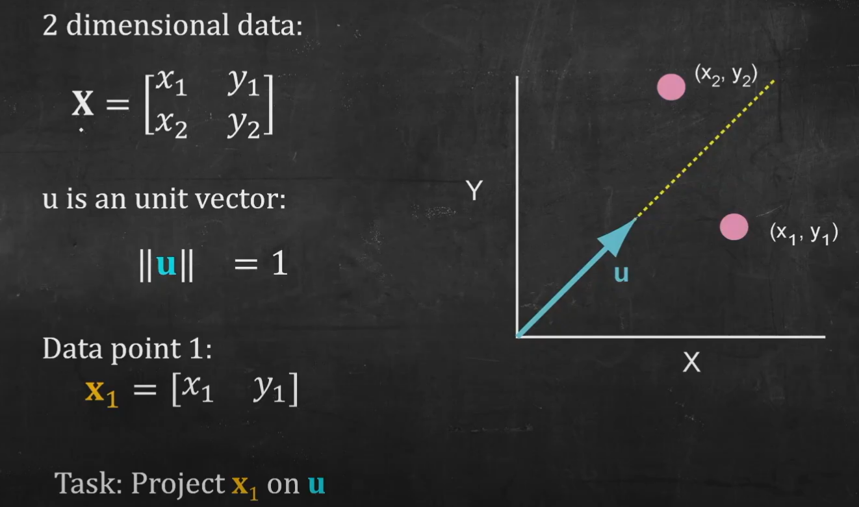
Projection of data

Slide 17
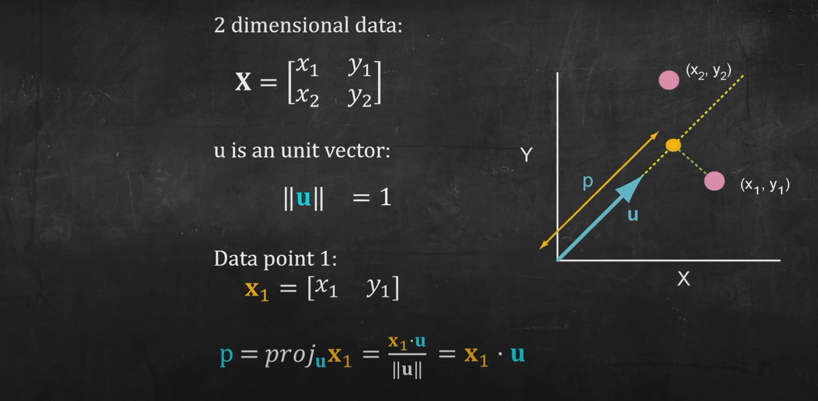
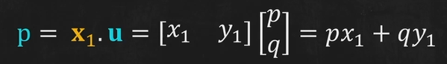

Slide 18
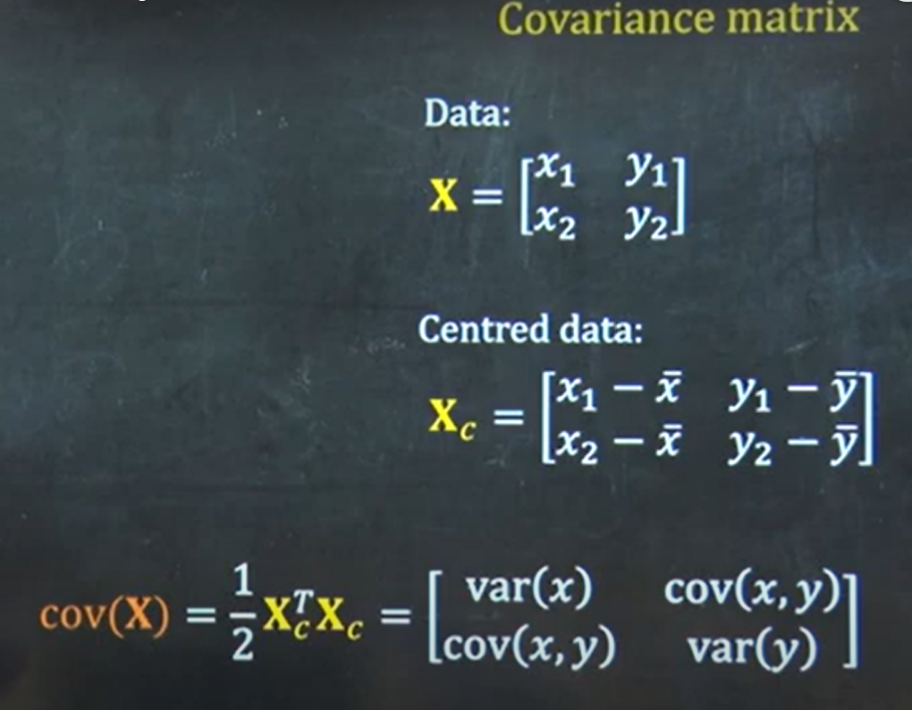
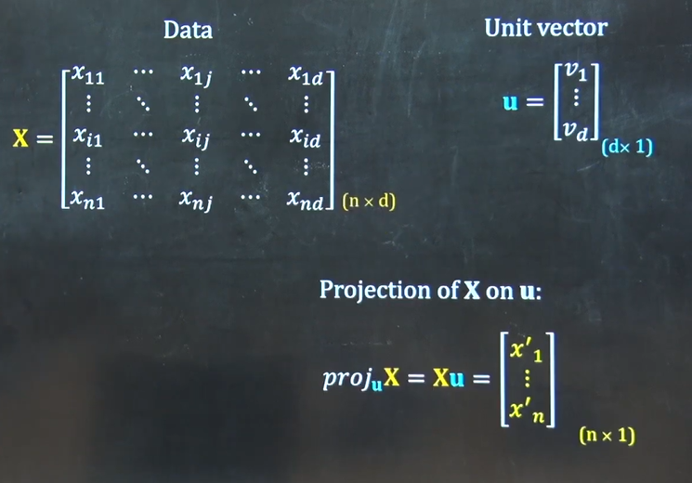

Slide 19
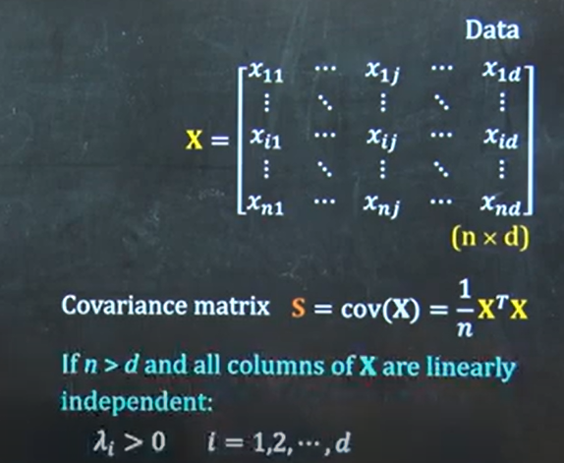
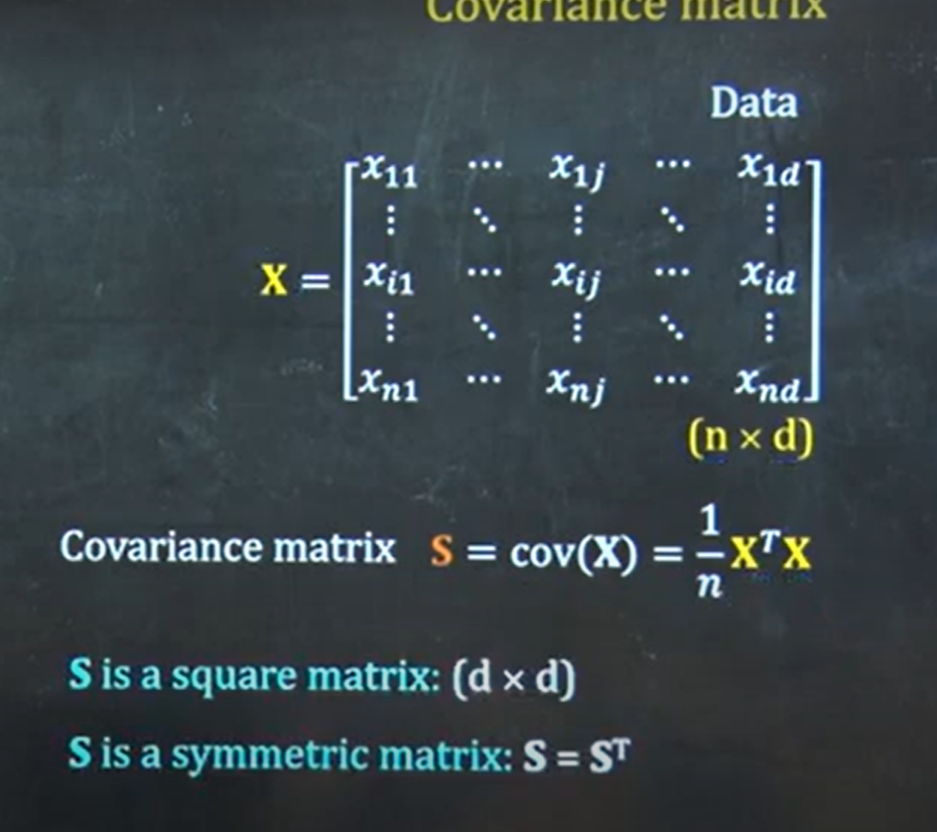
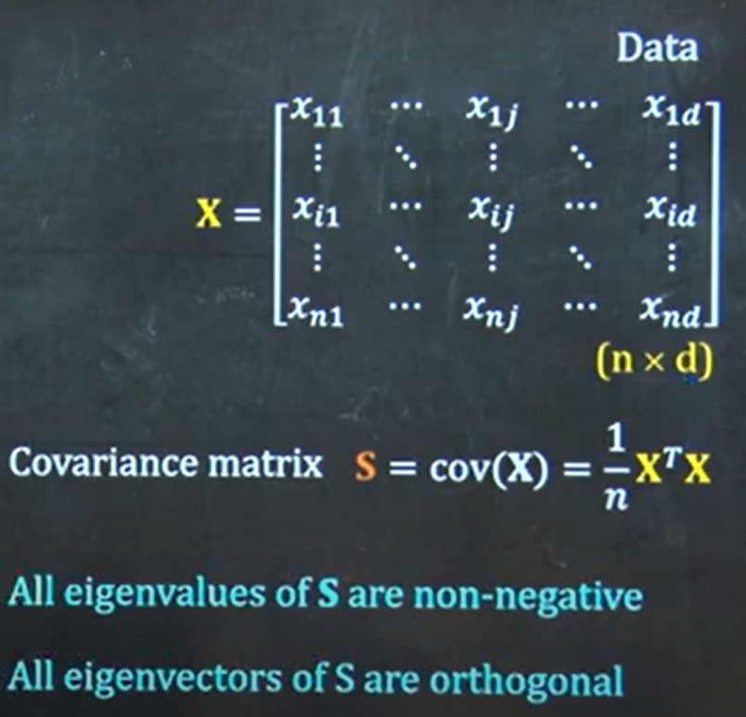
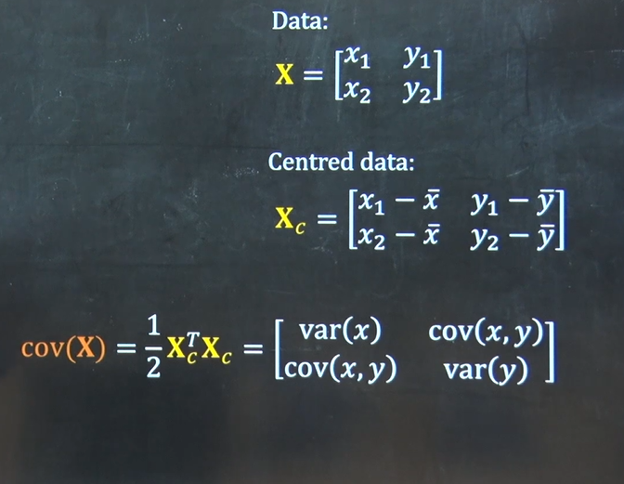
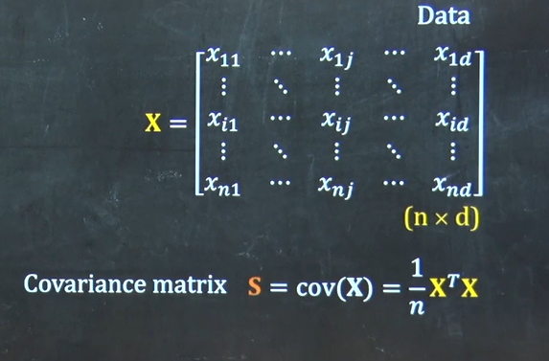

Covariance
S has d eigenvectors

Slide 20
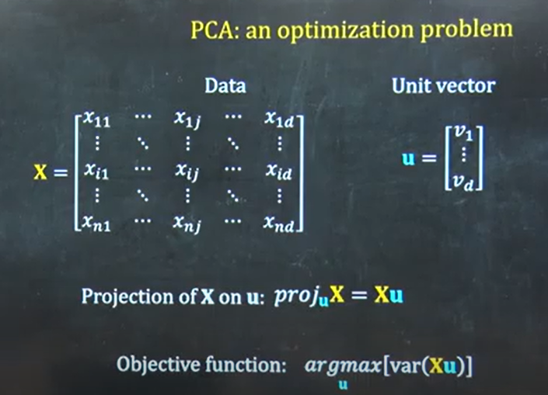
PCA: An optimization problem
Constrain:

Slide 21
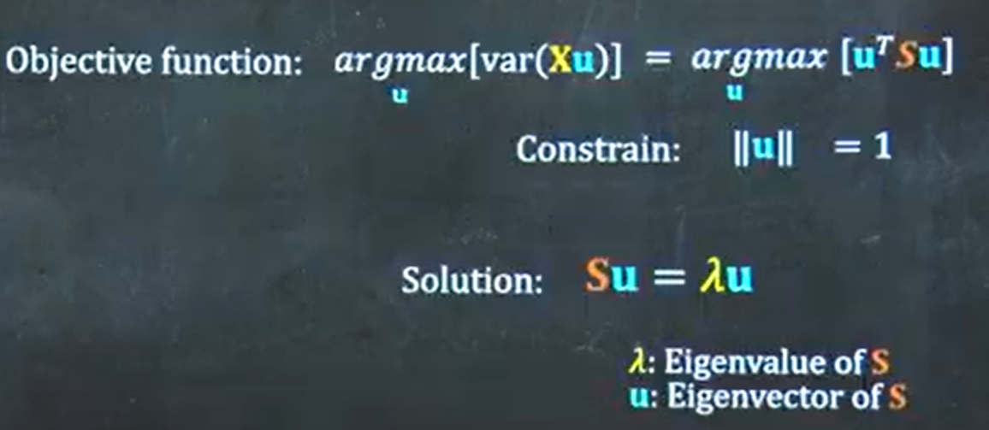


Slide 22
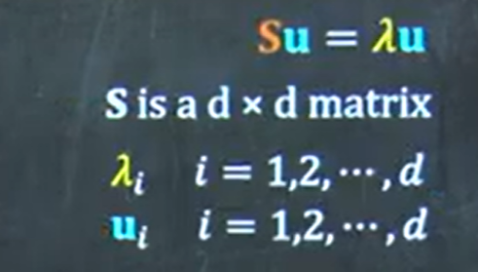
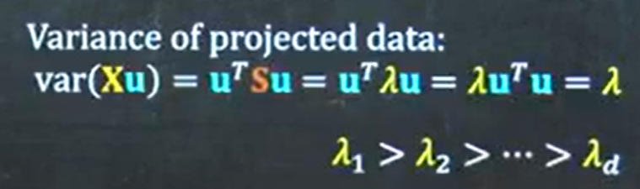

The Principal Components
Is the principal component 1

Slide 23

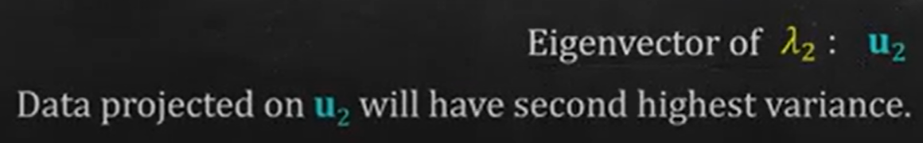
The Principal Components
u₂ Is the principal component 2
Is the principal component 1

Slide 24
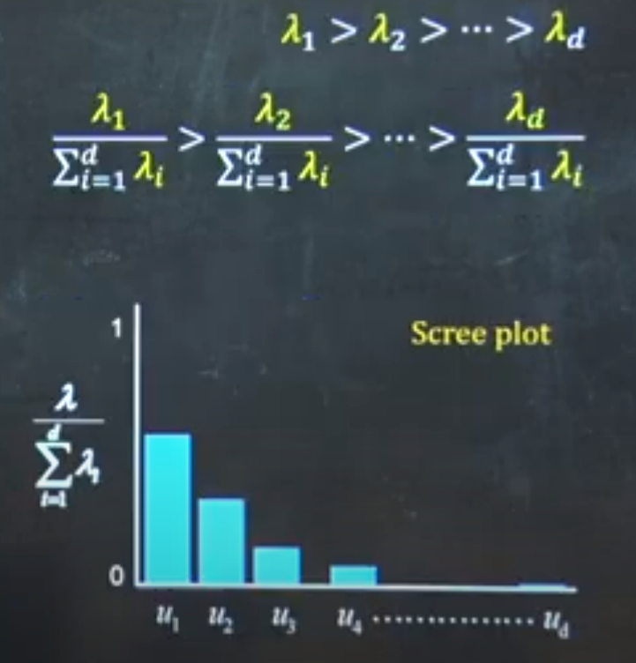
Selection of Principal Components
Normalization:
fraction of total variation

Slide 25
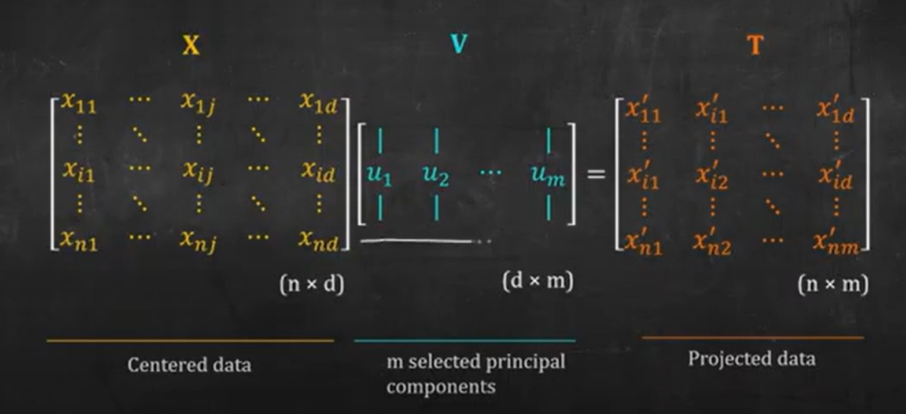
Project the data on PCs
Loading Matrix
Scores Matrix

Slide 26
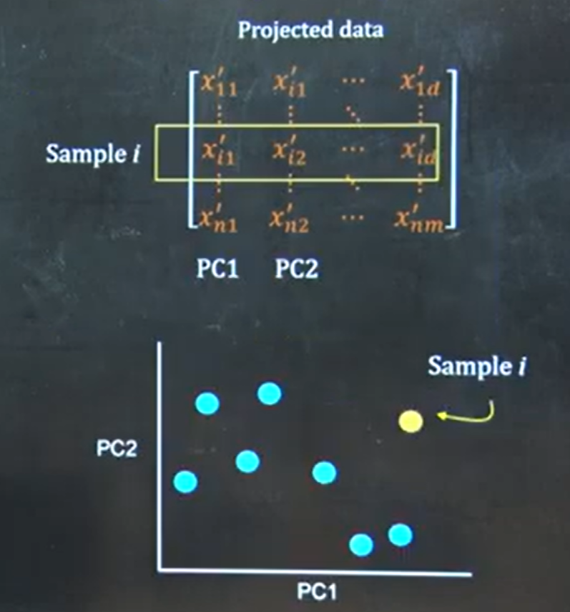
Visualization

Slide 27
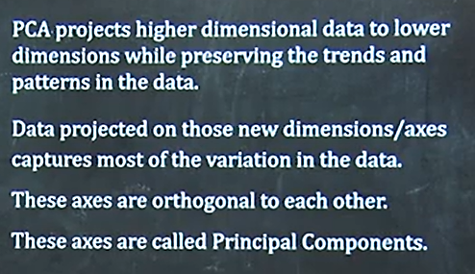
Key points

Slide 28
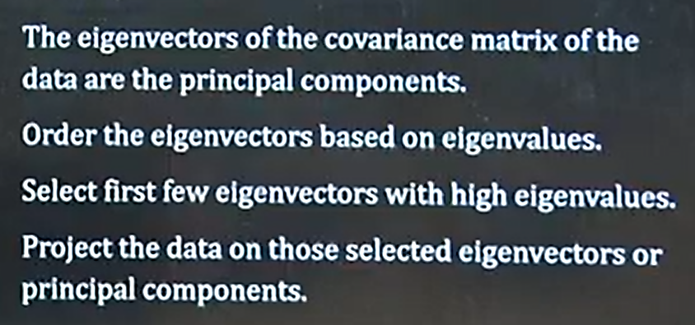
Key points

Slide 29
Principal Component Analysis :
Principal component analysis (PCA), as invented by Karl Pearson in 1901, is a procedure to convert a set of correlated variables into uncorrelated ones called principal components (Joliff, 2002).
The central idea of principal component analysis (PCA) is to reduce the dimensionality of a data set which consists of a large number of interrelated variables, while retaining as much as possible of the variation present in the data set.
This is achieved by transforming to a new set of variables, the principal components (PCs), which are uncorrelated, and which are ordered so that the first few retain most of the variation present in all of the original variables.
PCA works by considering the variance of each attribute because the high attribute shows the good split between the classes, and hence it reduces the dimensionality.

Slide 30
Principal Component Analysis :
Some real-world applications of PCA are image processing, movie recommendation system, optimizing the power allocation in various communication channels. It is a feature extraction technique, so it contains the important variables and drops the least important variable.
Some common terms used in PCA algorithm:
Dimensionality: It is the number of features or variables present in the given dataset. More easily, it is the number of columns present in the dataset.
Correlation: It signifies that how strongly two variables are related to each other. Such as if one changes, the other variable also gets changed. The correlation value ranges from -1 to +1. Here, -1 occurs if variables are inversely proportional to each other, and +1 indicates that variables are directly proportional to each other.
Orthogonal: It defines that variables are not correlated to each other, and hence the correlation between the pair of variables is zero.
Eigenvectors: If there is a square matrix M, and a non-zero vector v is given. Then v will be eigenvector if Av is the scalar multiple of v.
Covariance Matrix: A matrix containing the covariance between the pair of variables is called the Covariance Matrix.

Slide 31
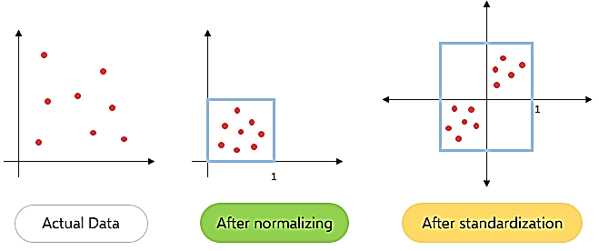
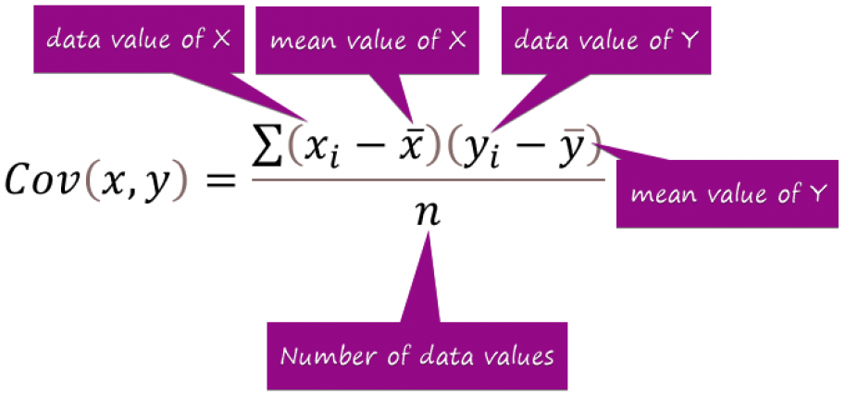
PCA terminologies :
Standardizing data – Scaling our dataset within a specific range for unbiased output.
Covariance matrix – Used for calculating interdependencies between the features or variables and also helps in reduce it to improve the performance

Slide 32
PCA terminologies :
Eigenvalues and Eigenvectors –
Eigenvectors’ purpose is to find out the largest variance that exists in the dataset to calculate Principal Component.
Eigenvalue (means the magnitude of the Eigenvector), indicates variance in a particular direction and eigenvector is expanding or contracting, X-Y (2D) graph, without altering the direction
Higher eigenvalues indicate that more variance in the data is accounted for by the corresponding principal component

Slide 33
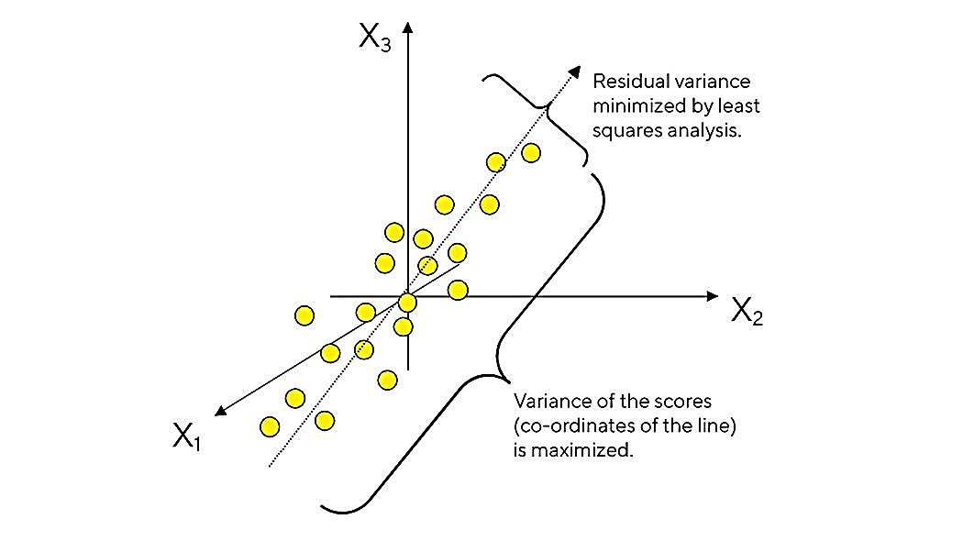
PCA
PCA forms the basis of multivariate data analysis based on projection methods.
Statistically, PCA finds lines, planes and hyper-planes in the K-dimensional space that approximate the data as well as possible in the least squares sense. A line or plane that is the least squares approximation of a set of data points makes the variance of the coordinates on the line or plane as large as possible.

Slide 34
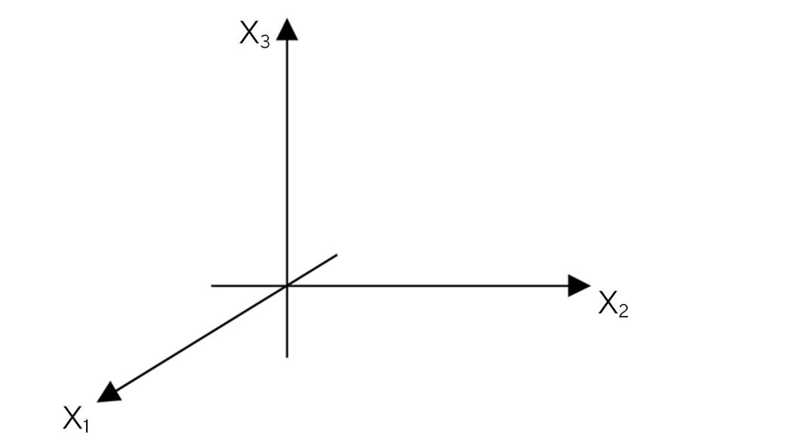
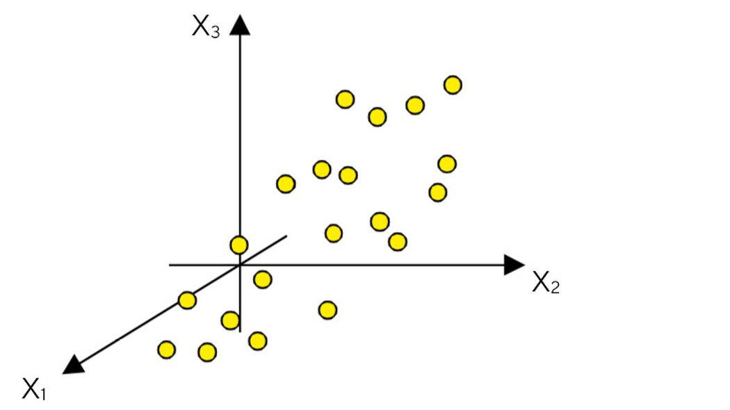
How PCA works ?
Consider a matrix X with N rows (aka "observations") and K columns (aka "variables").
Construct a variable space with as many dimensions as there are variables. Each variable represents one coordinate axis.
In the next step, each observation (row) of the X-matrix is placed in the K-dimensional variable space. Consequently, the rows in the data table form a swarm of points in this space.

Slide 35
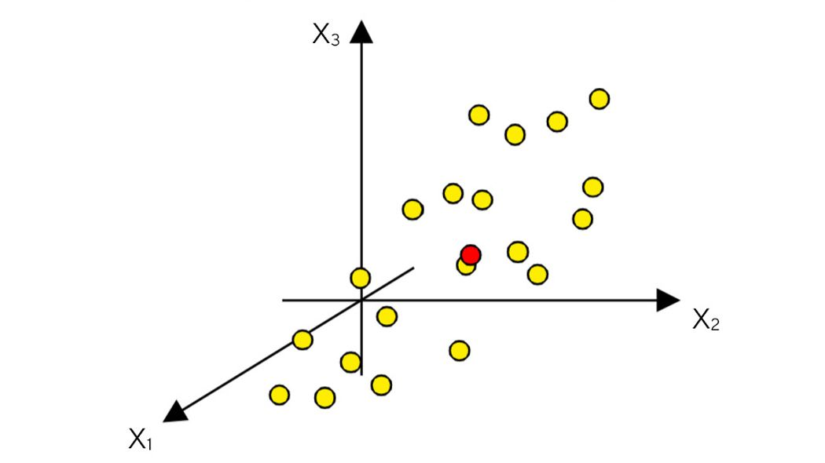
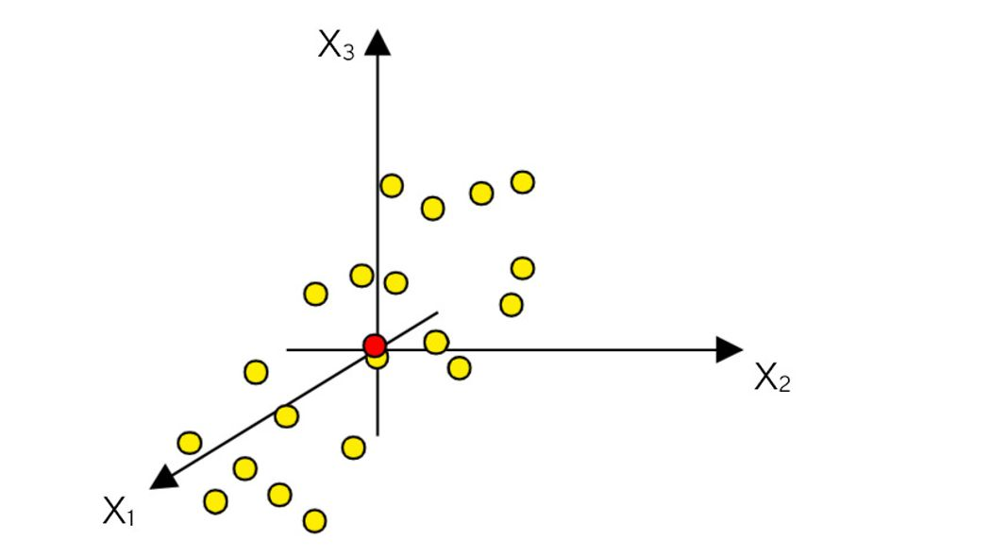
How PCA works ?
Mean-centering involves the subtraction of the variable averages from the data. The vector of averages corresponds to a point in the K-space.
The subtraction of the averages from the data corresponds to a re-positioning of the coordinate system, such that the average point now is the origin.
The mean-centering procedure corresponds to moving the origin of the coordinate system to coincide with the average point (here in red).

Slide 36
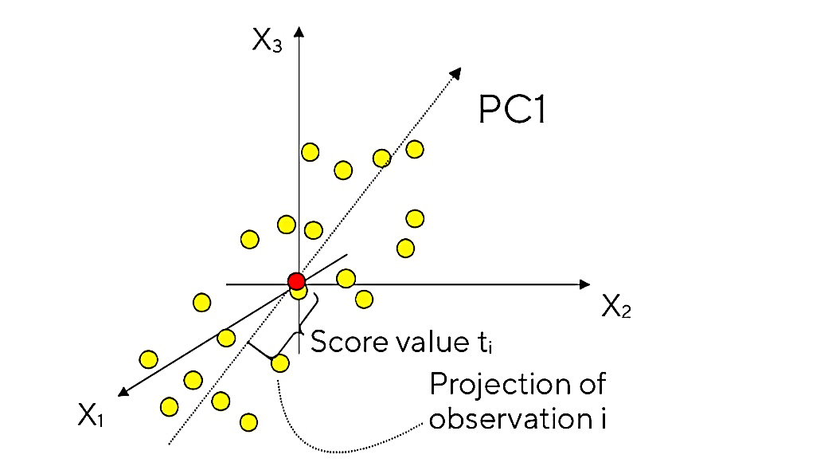
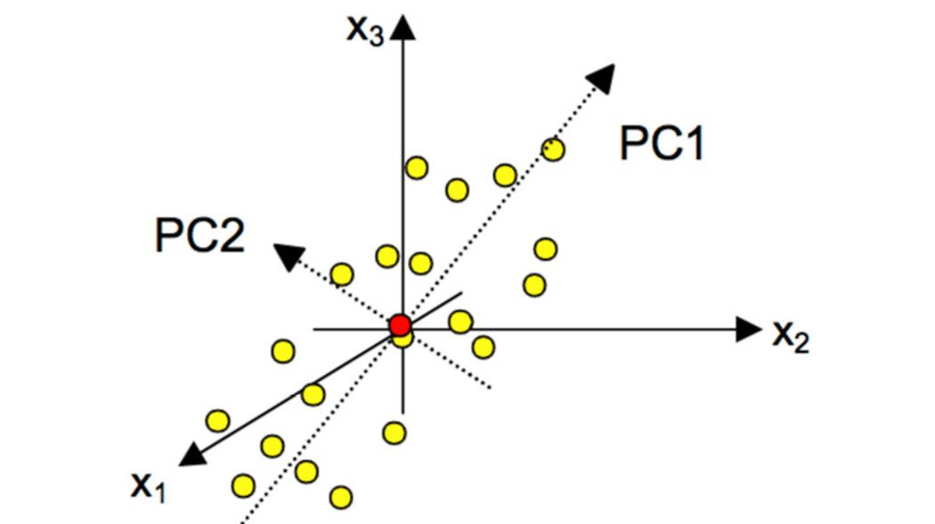
How PCA works ?
After mean-centering and scaling to unit variance, the data set is ready for computation of the first summary index, the first principal component (PC1).
This component is the line in the K-dimensional variable space that best approximates the data in the least squares sense. This line goes through the average point.
Each observation (yellow dot) may now be projected onto this line in order to get a coordinate value along the PC-line. This new coordinate value is also known as the score.
The second PC is also represented by a line in the K-dimensional variable space, which is orthogonal to the first PC. This line also passes through the average point, and improves the approximation of the X-data as much as possible.

Slide 37
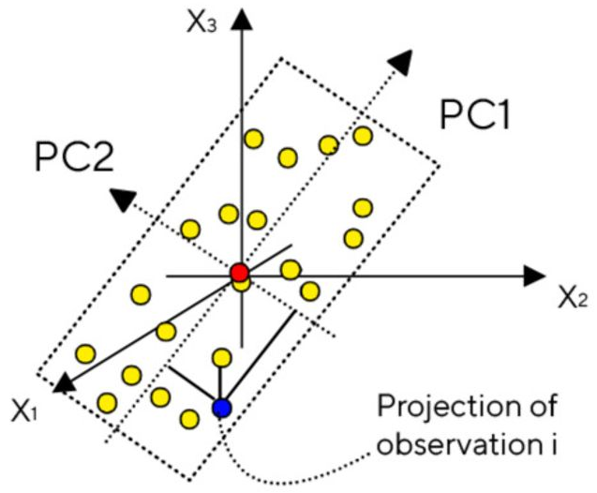
How PCA works ?
When two principal components have been derived, they together define a place, a window into the K-dimensional variable space.
By projecting all the observations onto the low-dimensional sub-space and plotting the results, it is possible to visualize the structure of the investigated data set.
The coordinate values of the observations on this plane are called scores, and hence the plotting of such a projected configuration is known as a score plot.

Slide 38
Steps for PCA algorithm :
Getting the dataset.
Representing data into a structure.
Standardizing the data.
Calculating the Covariance of Z.
Calculating the Eigen Values and Eigen Vectors
Sorting the Eigen Vectors.
Calculating the new features Or Principal Components
Remove less or unimportant features from the new dataset.

Slide 39
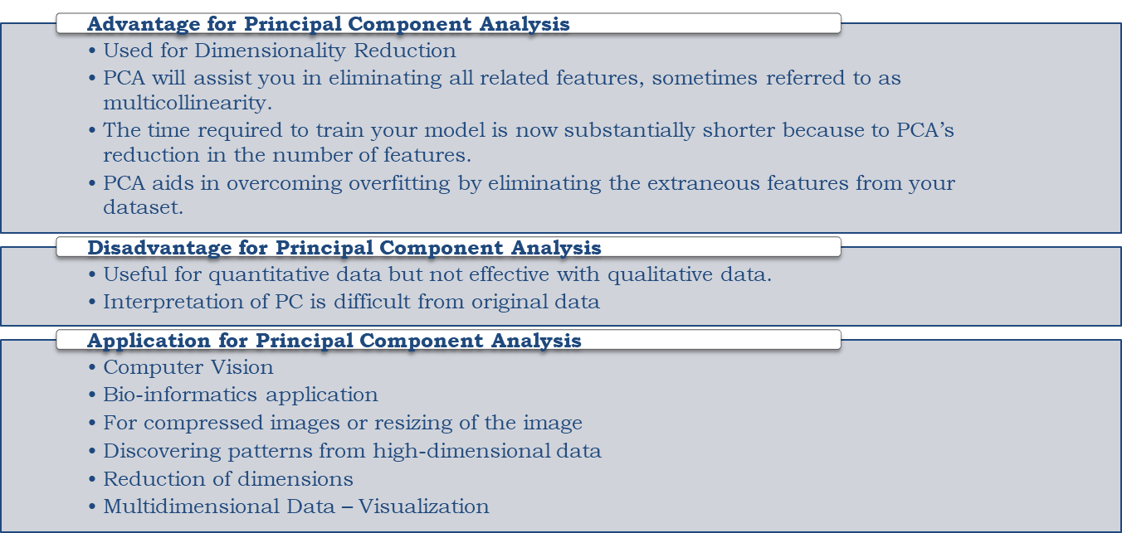

Slide 44
Principal Component Analysis :
Advantage for Principal Component Analysis
Used for Dimensionality Reduction
PCA will assist you in eliminating all related features, sometimes referred to as multicollinearity.
The time required to train your model is now substantially shorter because to PCA’s reduction in the number of features.
PCA aids in overcoming overfitting by eliminating the extraneous features from your dataset.
Disadvantage for Principal Component Analysis
Useful for quantitative data but not effective with qualitative data.
Interpretation of PC is difficult from original data
Application for Principal Component Analysis
Computer Vision
Bio-informatics application
For compressed images or resizing of the image
Discovering patterns from high-dimensional data
Reduction of dimensions
Multidimensional Data – Visualization

Slide 49
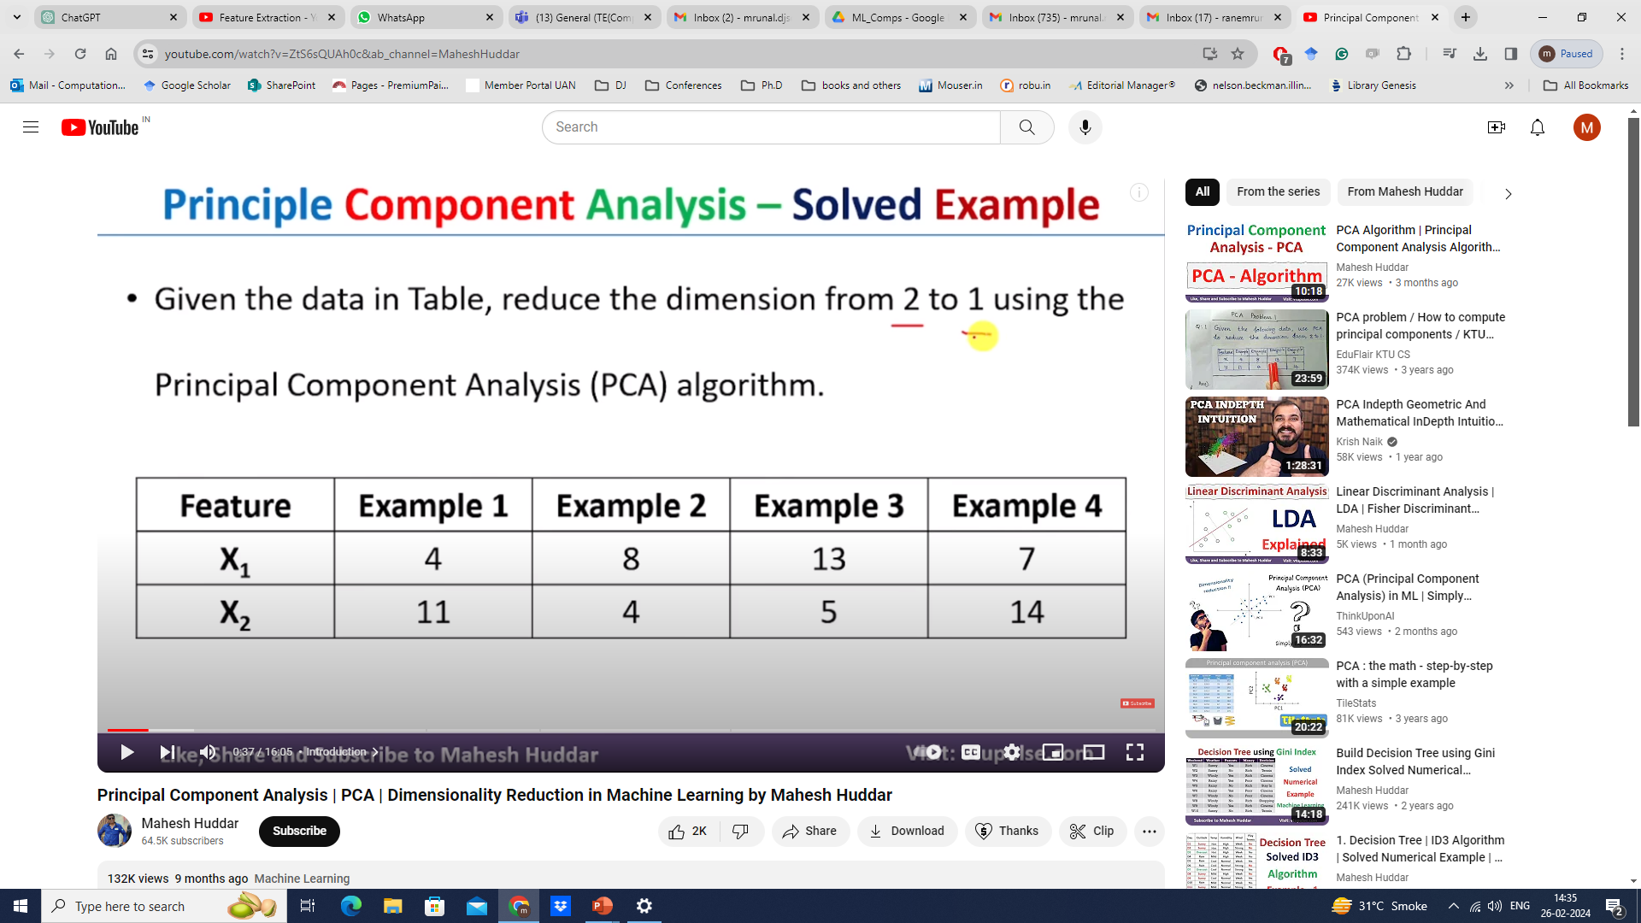

Slide 50
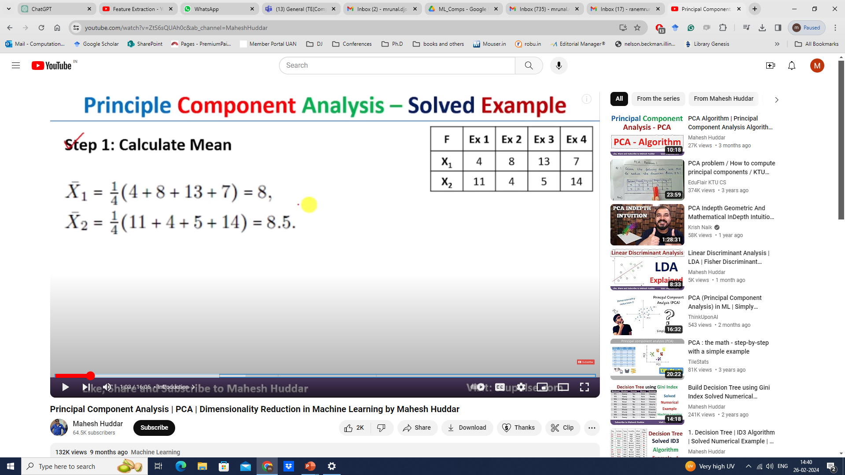

Slide 51
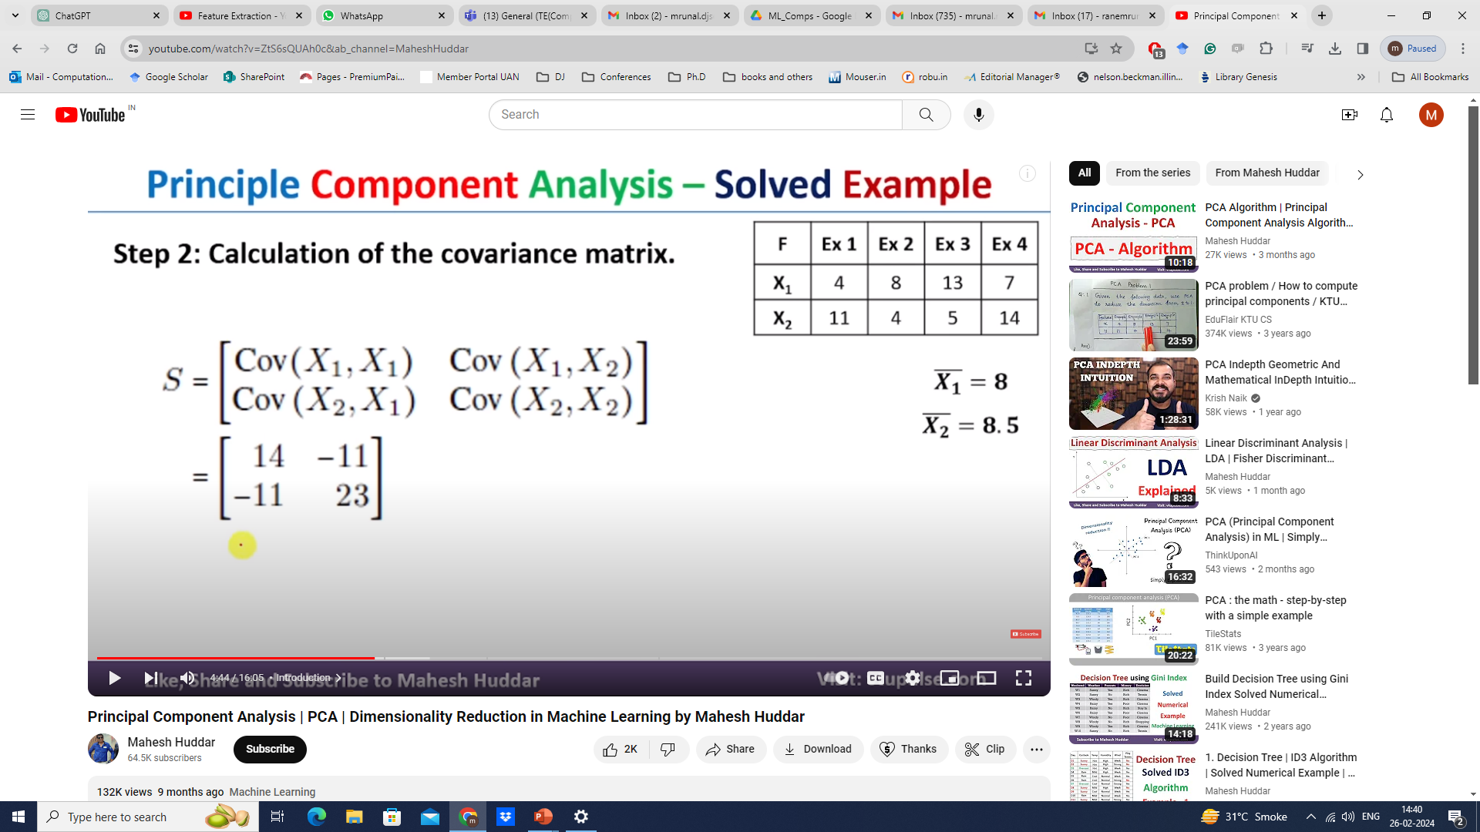

Slide 52
